Slide 1
DEPARTMENT OF PHYSICS
SRM INSTITUTE OF SCIENCE AND TECHNOLOGY
18PYB103J –Semiconductor Physics
Concept of phonons
Concept of Brillouin Zone (1D)
Lecture 8
18PYB103J Module-I Lecture 8

Slide 2
CONCEPT OF PHONONS
Any solid crystal consists of atoms bound into a specific repeating three-dimensional spatial pattern called a lattice.
Here the atoms behave as if they are connected by tiny springs, their own thermal energy or outside forces make the lattice vibrate.
This generates mechanical waves that carry heat and sound through the material.
A packet of these waves can travel throughout the crystal with a definite energy and momentum, so in quantum mechanical terms the waves can be treated as a particle, called a phonon.
A phonon is a definite discrete unit or quantum of vibrational mechanical energy, just as a photon is a quantum of electromagnetic or light energy.
18PYB103J Module-I Lecture 8

Slide 3
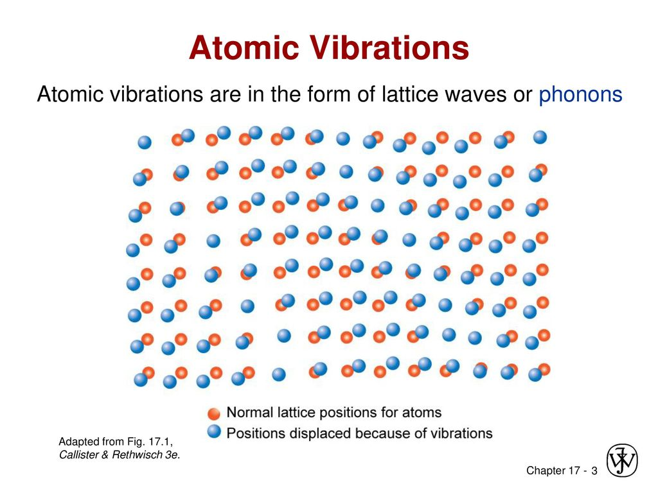
Concept of Phonons
18PYB103J Module-I Lecture 8

Slide 4
Phonon:
A photon is the smallest unit of light. Similarly, for sound, the smallest unit is called phonon. In a lattice structure, vibrations are created by atoms. The quantized, lowest state energy of vibration is called phonon.
Atoms were considered as rigid, with atoms stuck in their lattice. In reality, atoms can be considered as simple harmonic oscillators. The harmonic oscillator has a ground state energy and an associated vibrational mode even at 0 ° K.
It is named phonons because at high energy levels long wavelength phonons give rise to sound. According to quantum mechanics, similar particles have wave nature, waves must also have particle nature. So, phonon is also treated as quasi particle. Similar to particles, these waves can carry throughout the crystal, heat, energy and momentum.
18PYB103J Module-I Lecture 8

Slide 5
The important application of phonons is in the field of superconductivity, where the electrical resistance of certain materials becomes zero near absolute zero.
In ordinary crystals, there is a loss of energy as heat as the electrons collide with impurities. But in superconductors, at low temperatures, they tend to attract slightly because of phonons. Now the movement occur as a coherent group thus minimizing energy loss.
Phonons also have important application in detectors like Cryogenic Dark Matter Search, which aim to detect even the slightest vibration in a crystal lattice caused by even a single phonon.
18PYB103J Module-I Lecture 8

Slide 6
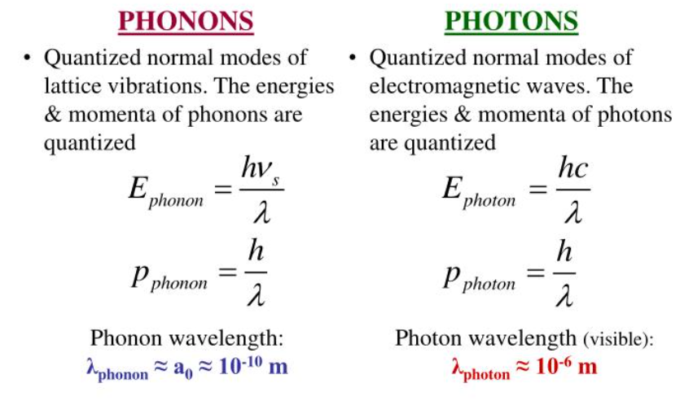
Comparison between Phonons and Photons
18PYB103J Module-I Lecture 8

Slide 7
Concept of Brillouin zone
The different Brillouin zones correspond to primitive cells of a different type that come up in the theory of electronic levels in a periodic potential.
The first Brillouin zone is considered as the Wigner-Seitz (WS) primitive cell in the reciprocal lattice. In other words, the first Brillouin zone is a geometrical construction to the WS primitive cell in the k-space.
In a direct lattice, the procedure of drawing a WS cell is as follows:
Draw lines to connect a given lattice points to all nearby lattice points.
i) Draw lines to connect a given lattice points to all nearby lattice points.
ii) Draw new lines or plane at the mid point and normal to the lines in(i) .
iii) The smallest volume enclosed in this way is the WS primitive cell.
18PYB103J Module-I Lecture 8

Slide 8
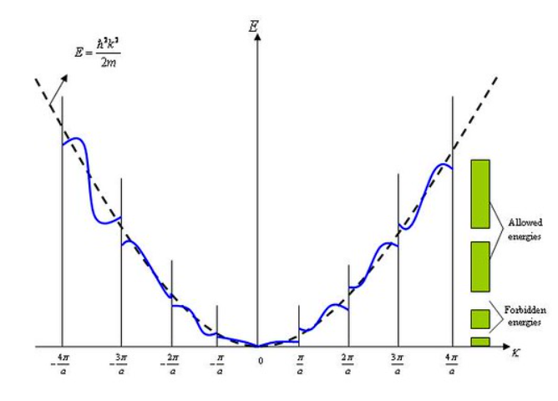
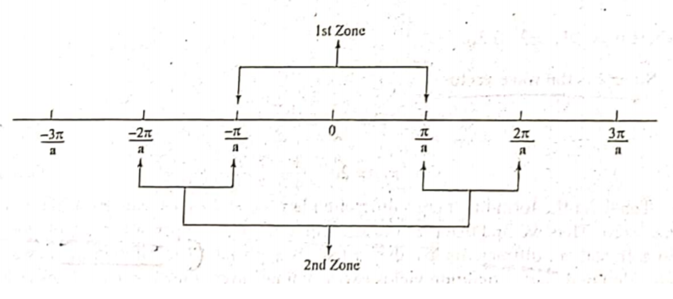
18PYB103J Module-I Lecture 8

Slide 9
Remarks:
- The planes divide the Fourier space of the crystal into fragments as shown for a square lattice.
- The central square is a primitive cell of the reciprocal lattice. It is a Wigner-Seitz cell of the reciprocal lattice (called the first Brillouin zone).
- The first Brillouin zone is the smallest volume entirely enclosed by the planes.
18PYB103J Module-I Lecture 8

Slide 10
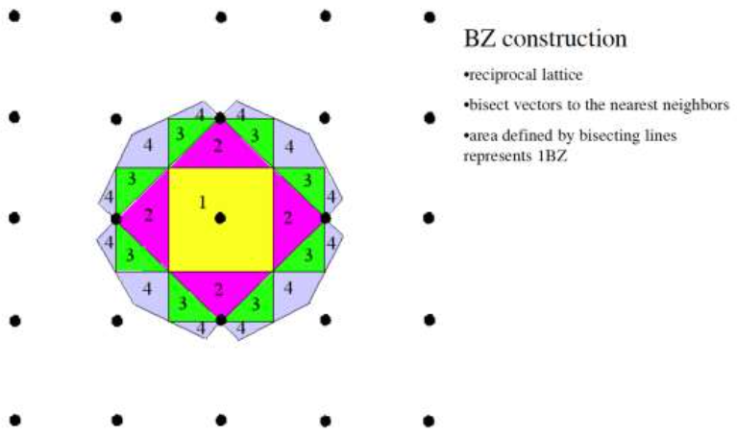
18PYB103J Module-I Lecture 8

Slide 11
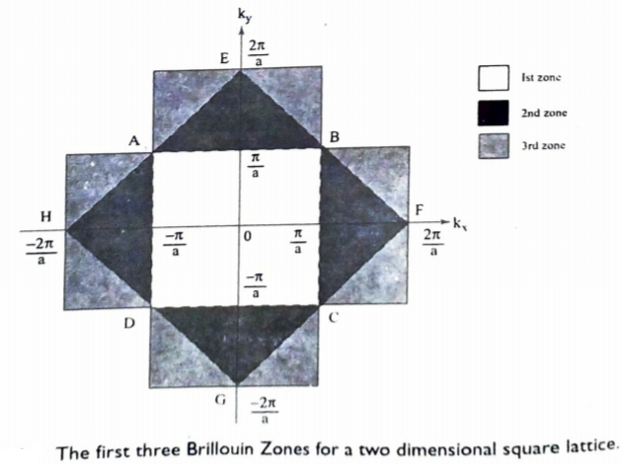
18PYB103J Module-I Lecture 8

Slide 12
Conclusion:
Wigner-Seitz cell: smallest possible primitive cell, which consist of one lattice point and all the surrounding space closer to it than to any other point. The construction of the W-S cell in the reciprocal lattice delivers the first Brillouin zone (important for diffraction)
The importance of Brillouin zone:
The Brillouin zones are used to describe and analyze the electron energy in the band energy structure of crystals.
18PYB103J Module-I Lecture 8

